Slide 1

Redis: An
In-Memory Data Structure Store
Redis is an open-source, in-memory data store known for its high performance and versatility. It's a popular choice for various applications, including caching, session management, and real-time analytics.
Notes:
<number>

Slide 2
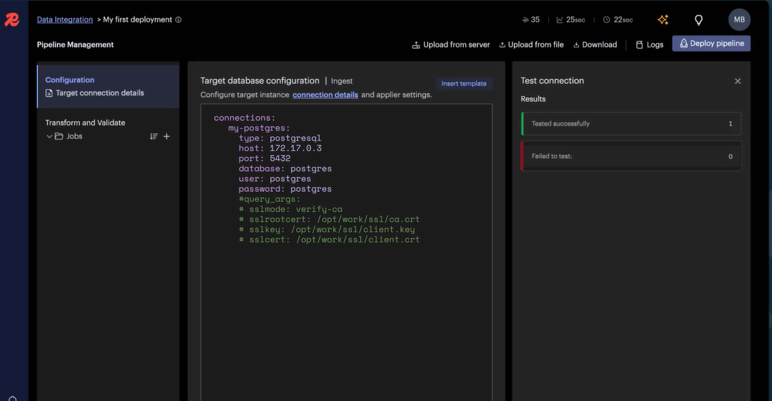
Redis vs. Relational Databases
Redis
Relational Databases
In-memory, high performance, ideal for caching, session management, and real-time data. Data stored as key-value pairs, lists, sets, hashes, and sorted sets.
Disk-based, structured data storage, ideal for transactional data, complex queries, and data integrity. Data organized into tables with rows and columns.
Notes:
<number>

Slide 3
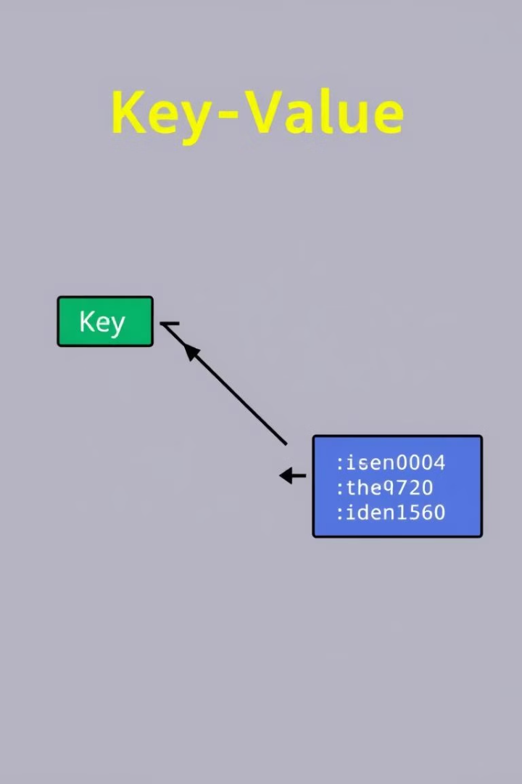
Key-Value Data Model
Key
Value
Unique identifier for each data entry. Typically a string, but can be other data types.
Actual data associated with the key. Can be a string, list, set, hash, or sorted set.
Notes:
<number>

Slide 4
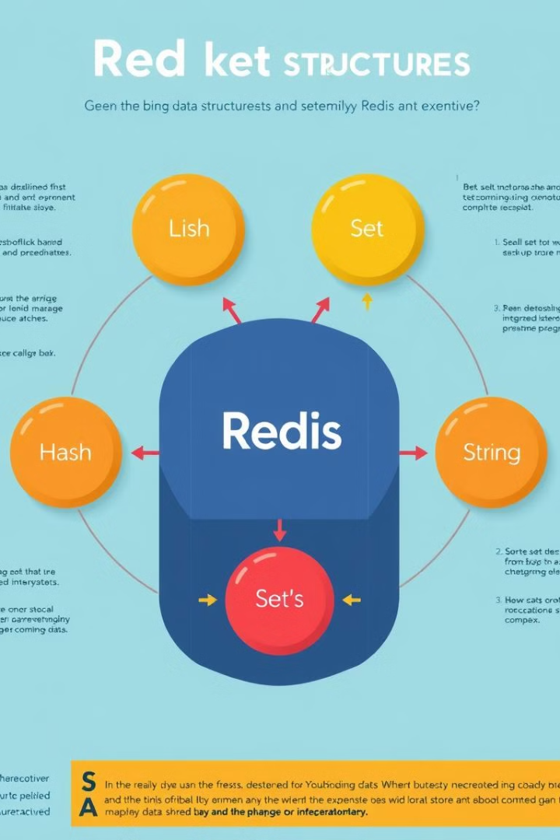
Redis Data Structures
1
Strings
2
Lists
Simple key-value pairs where the value is a string.
Ordered collections of strings, used for queues, stacks, and sorted lists.
3
Sets
4
Hashes
Unordered collections of unique strings, useful for membership checks and set operations.
Key-value pairs within a key, allowing for storing structured data like objects.
Notes:
<number>

Slide 5
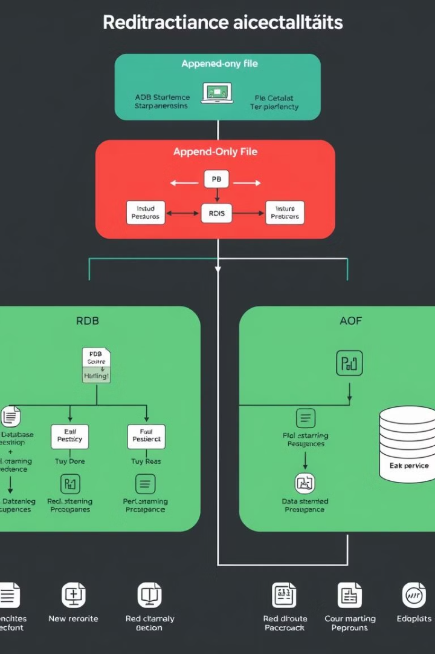


Redis Persistence
RDB (Redis Database Backup)
Creates periodic snapshots of the entire Redis dataset, ensuring data recovery in case of failure.
AOF (Append-Only File)
Logs all write operations to a file, allowing for recovering data from the last successful write.
Notes:
<number>

Slide 6
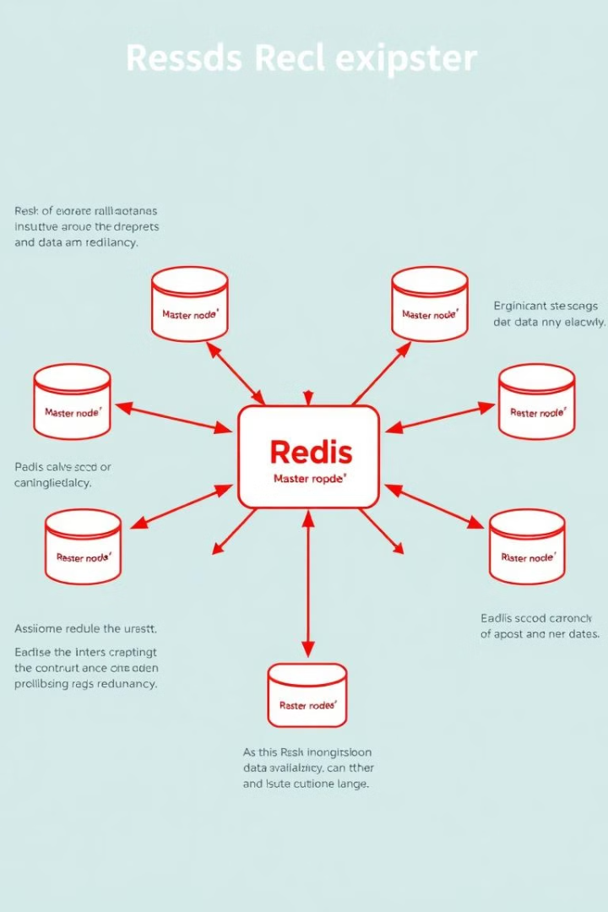
Redis Replication and High Availability
Master Node
Primary node responsible for handling all write operations and data updates.
Slave Nodes
Secondary nodes that replicate data from the master node, providing read-only access and failover support.
Notes:
<number>

Slide 7



Redis Pub/Sub and Messaging Patterns
Publish/Subscribe
Message Queues
Allows clients to subscribe to channels and receive messages published by other clients.
Uses lists as message queues, allowing for asynchronous communication and task processing.
Notes:
<number>

Slide 8
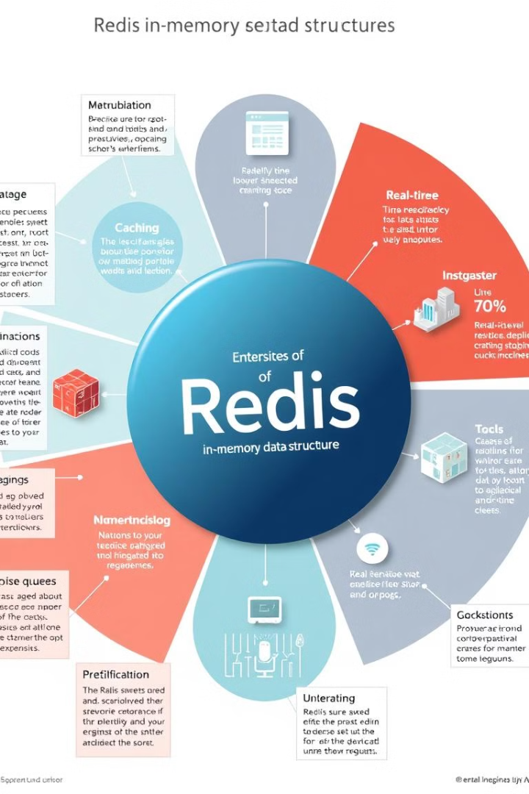
Redis Use Cases and Applications
1
Caching
Speeding up web applications by storing frequently accessed data in memory.
2
Session Management
Maintaining user session data in a highly scalable and reliable way.
3
Real-Time Analytics
Processing and analyzing large amounts of data in real-time, allowing for quick insights.
4
Messaging
Facilitating communication between different parts of an application, enabling asynchronous interactions.
Notes:
<number>

Slide 9

Conclusion and Key Takeaways
Redis is a powerful and versatile in-memory data store that offers high performance, scalability, and flexibility. Its key-value data model, data structures, persistence options, and messaging capabilities make it suitable for a wide range of applications.
Notes:
<number>

